Slide 1

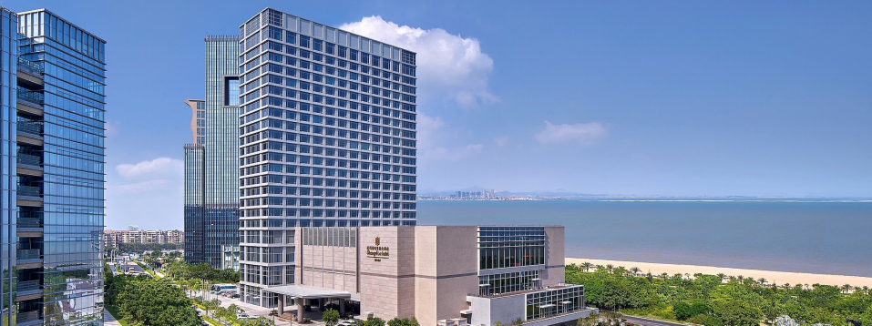
New Vitality. New Urban Realm.-Shangri-La Xiamen
May 14 – 16, 2026
17th Rare Earth Summit （Discount Code:RES140526）
Online Room Booking Guide

Slide 2

The online booking portal will close on May 11, 2026.
Please book early to secure your room.
Deluxe Twin/King Room：RMB800nett with one or two daily breakfasts
Deluxe Sear-view Twin/King Room：RMB900 nett with one or two daily breakfasts
Horizon Sea View King Room：RMB1200 nett with one or two daily breakfasts
Executive Sea View Suite Room： RMB2000 nett with one or two daily breakfasts

Slide 3
1.Open one of the following links to access the booking interface:
Chinese version:
https://www.shangri-la.com/cn/xiamen/shangrila/reservations/select-room-rate/?hotel=%E5%8E%A6%E9%97%A8%E9%A6%99%E6%A0%BC%E9%87%8C%E6%8B%89&hotelCode=SLXM&timeZone=%2B8&city=%E5%8E%A6%E9%97%A8&cityEn=Xiamen&checkInDate=2026-05-14&checkOutDate=2026-05-16&rooms=%5B%7B%22adultNum%22%3A1%2C%22childNum%22%3A0%7D%5D&confirmationNo=&specialCode=RES140526&specialCodeType=Group&country=&specialCodeToken=&flexible=false&roomClassCodeList=
English version:
https://www.shangri-la.com/en/xiamen/shangrila/reservations/select-room-rate/?hotel=%E5%8E%A6%E9%97%A8%E9%A6%99%E6%A0%BC%E9%87%8C%E6%8B%89&hotelCode=SLXM&timeZone=%2B8&city=%E5%8E%A6%E9%97%A8&cityEn=Xiamen&checkInDate=2026-05-14&checkOutDate=2026-05-16&rooms=%5B%7B%22adultNum%22%3A1%2C%22childNum%22%3A0%7D%5D&confirmationNo=&specialCode=RES140526&specialCodeType=Group&country=&specialCodeToken=&flexible=false&roomClassCodeList=

Slide 4
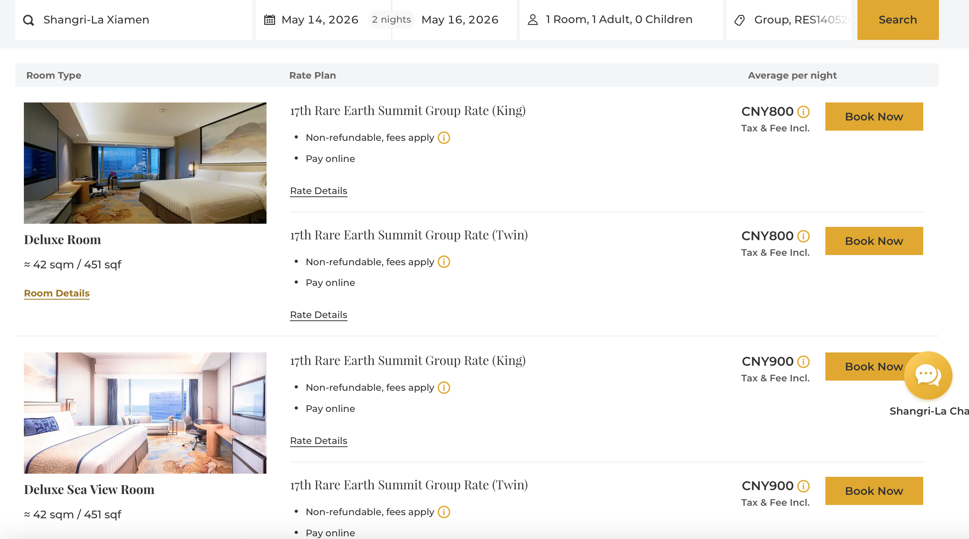
2.Select Your Room
Choose your preferred check-in and check-out dates.
Select your desired room type.
Click the "Book Now".

Slide 5
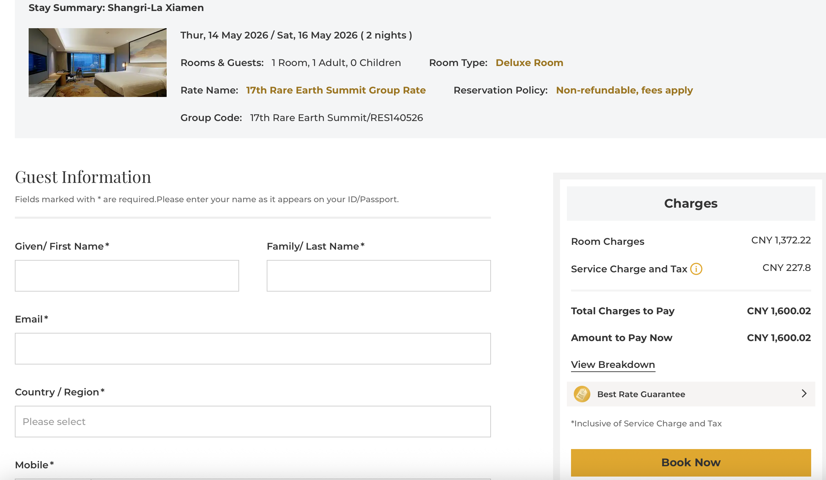
3.Enter Guest Details & Payment
Fill in the required guest information.
The total price for your stay will be displayed here.
Click "Book Now"
On the next page, choose your preferred payment method.
Click "Complete Booking" to finalize your reservation.

Slide 6
4.Booking Confirmation
Upon successful booking, a confirmation email will be sent to the address you provided.
Please double-check all details on the final screen:Hotel Name、Check-in / Check-out Dates、Room Type、Total Price、Confirmation Number.
Keep your confirmation number safe. You will need it for check-in.
If you need to check in early or check out late, and there is no matching room availability in the booking link, you can contact the hotel at any time to handle the booking.
If you have any questions, please Call 0592-838 5888 to the Reservation Department.
Please call and inform that you are a guest from Asia Metal (17th Rare Earth Summit) team.

Slide 7
Contact Us
Shangri-La Xiamen
Address：No. 168 Taidong Road, Guanyinshan International Business Center
Siming District, Xiamen, Fujian Province 361008, China
Phone: (86 592) 838 5888
Fax: (86 592) 838 5889
Website: www.shangri-la.com/xiamen

